Slide 1

Is this image that image?
Asserting integrity beyond the fixity
Difference depth analysis
In short, a process that compares an image at the pixel level, that can indicate how much change there is between two images, and where that change is found in the images.
Method
We start by making a “difference” image. Image A is subtracted from image B at the channel/pixel level, and the resulting values are recorded as a new pixel, and incorporated into a new image.
The difference image is converted to greyscale (to reduce the computation / data complexity).
We can use this “difference” image to generate some useful data and comparative analysis/images.
By assessing each pixel in the difference image, we can see how different each pixel is between the source images. If a pixel is set to [0] we know it’s the same in both images, if the pixel is [255] we know its completely different (e.g. image A pixel is [r:0, g:0, b:0], image B image pixel is [r:255, g:255, b:255]. We can make new images that show what how many pixels are affected at any particular change depth, from no change [0] to complete change [255].
Why?
Converting an image from one format to another may result in change to the image - how can we know where that change is, and how much change is found?
Creating access copies of master files must meet a fidelity criteria. This method can help set that criteria and show if it has been met.
Some processing to non-image formats that are rendered visually results in fixity change (e.g. doc, pdf, etc). Resulting files can be converted to images and changes to layout, fonts, colours etc can be quickly assessed at the pixel level and used to assess impact of processing by non-technical SMEs
The Problem
Its common in digital preservation to use file fixity to test for differences between two digital items. The fixity process results in a unique digital “fingerprint” that means we can easily ask the question “is this file the same as that file?” and get a True/False answer.
In image science its common to use root means squared error (RMSE) or similar mathematical functions to find a value to describe the amount of difference between two images.
Neither of these processes are sufficient as a measurement when we (1) know there is a difference between two images, and (2) we want to assess the impact / amount of that difference. We need a new tool – difference depth.
All examples and required code is in this repo: https://github.com/NLNZDigitalPreservation/diff_depth_analysis
JAY.GATTUSO@DIA.GOVT.NZ

Slide 2
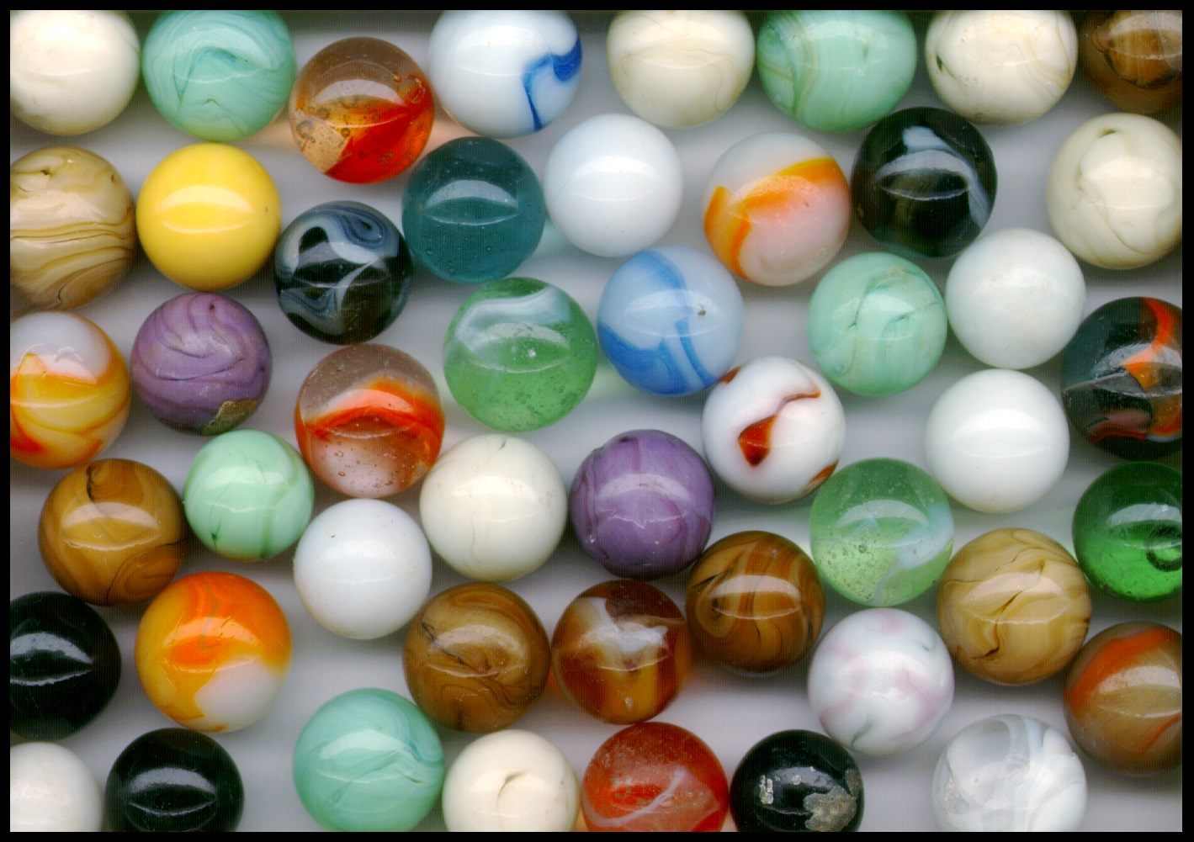
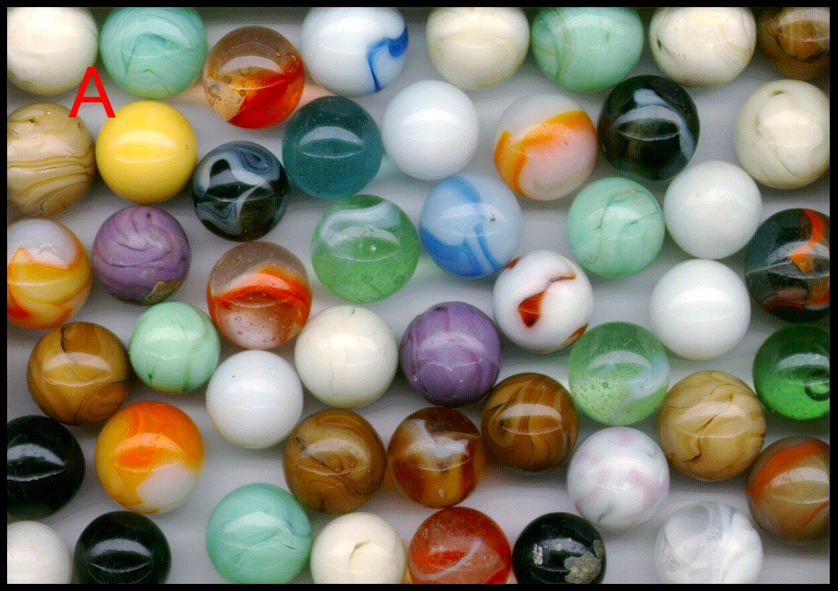
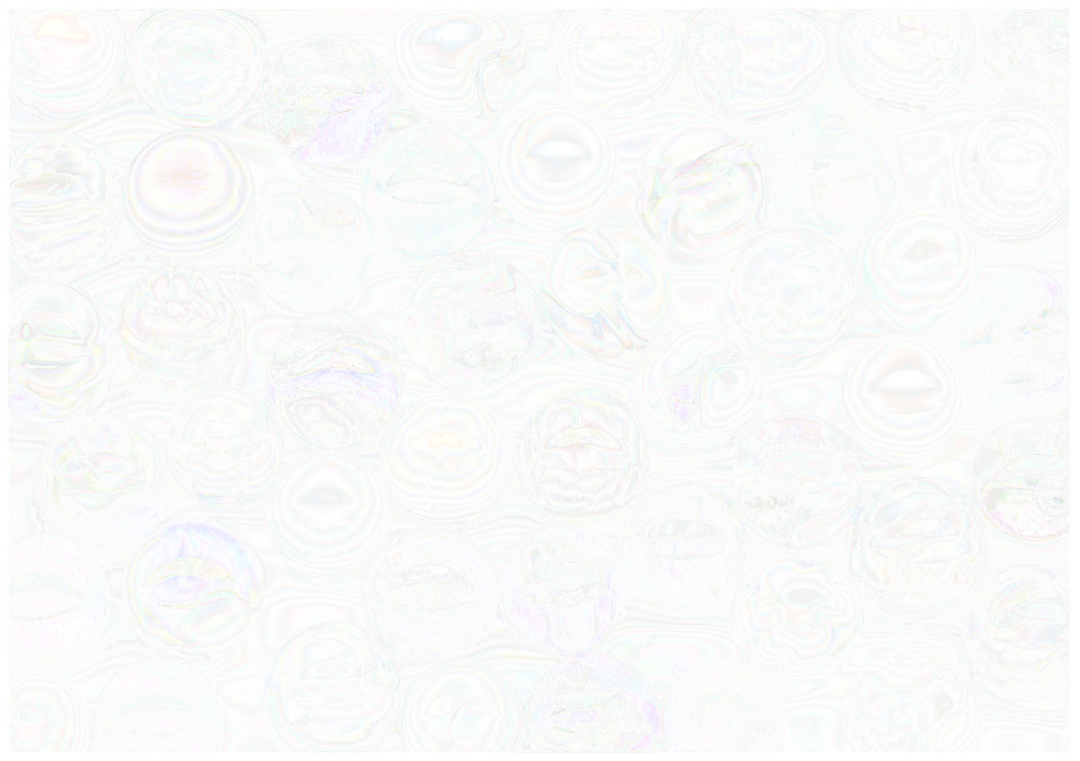
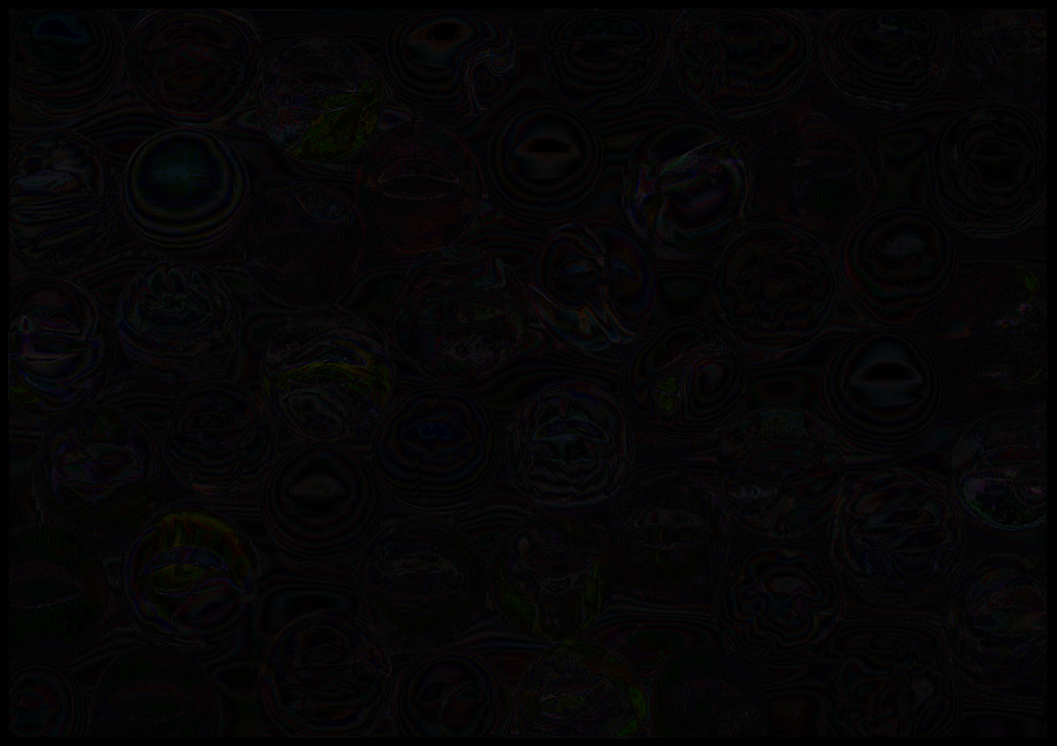
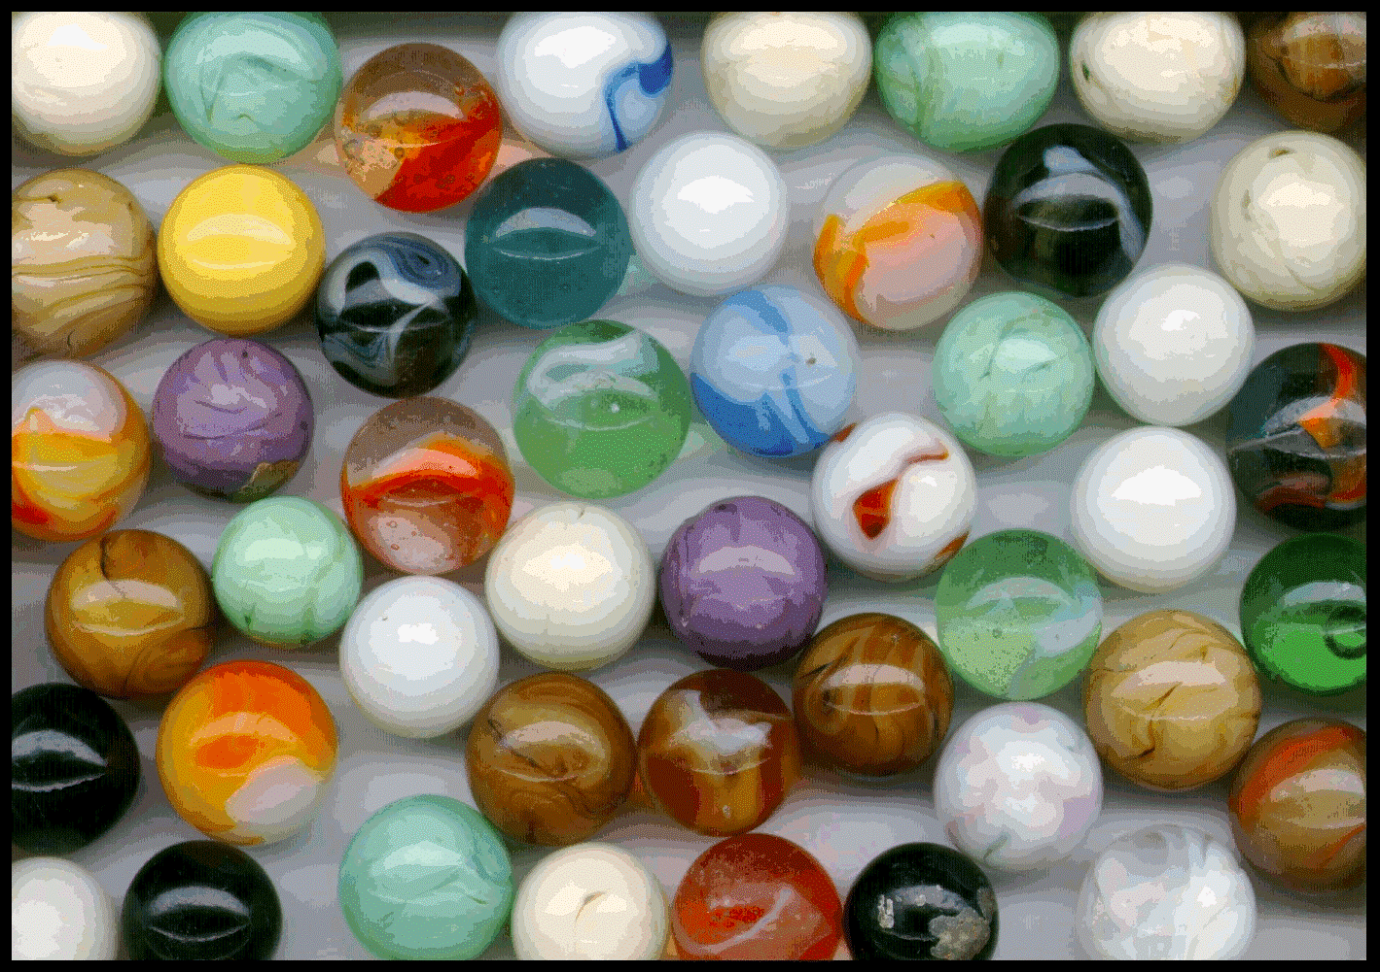
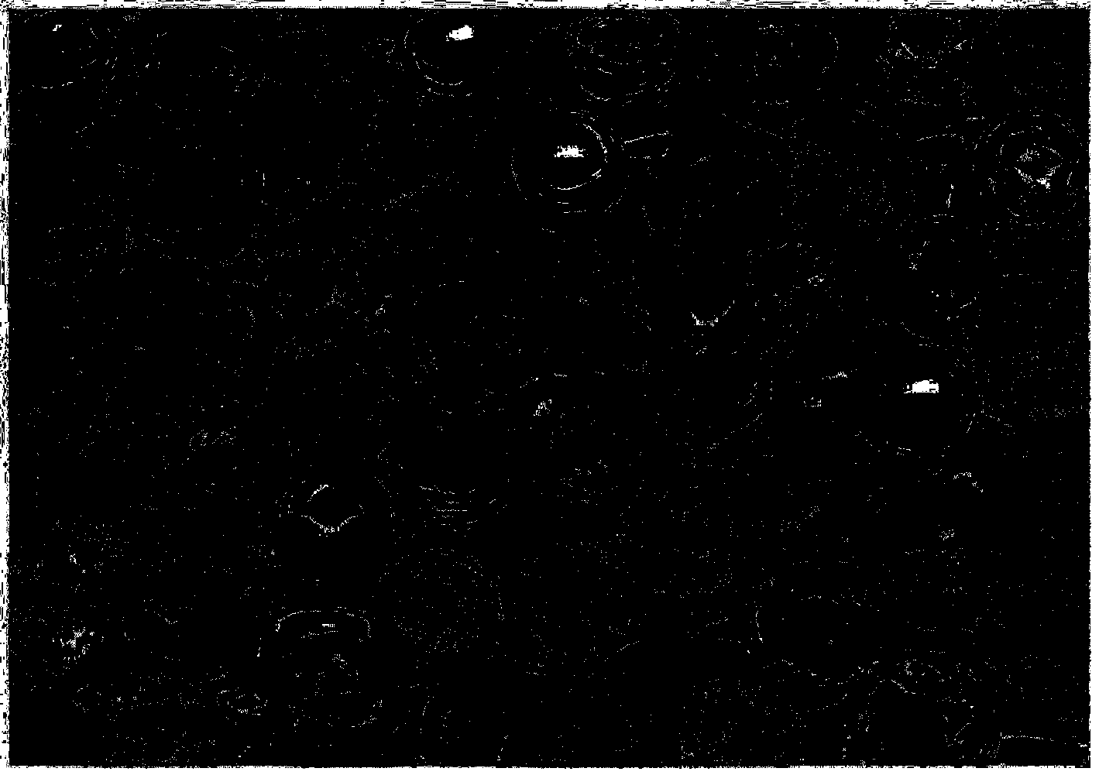

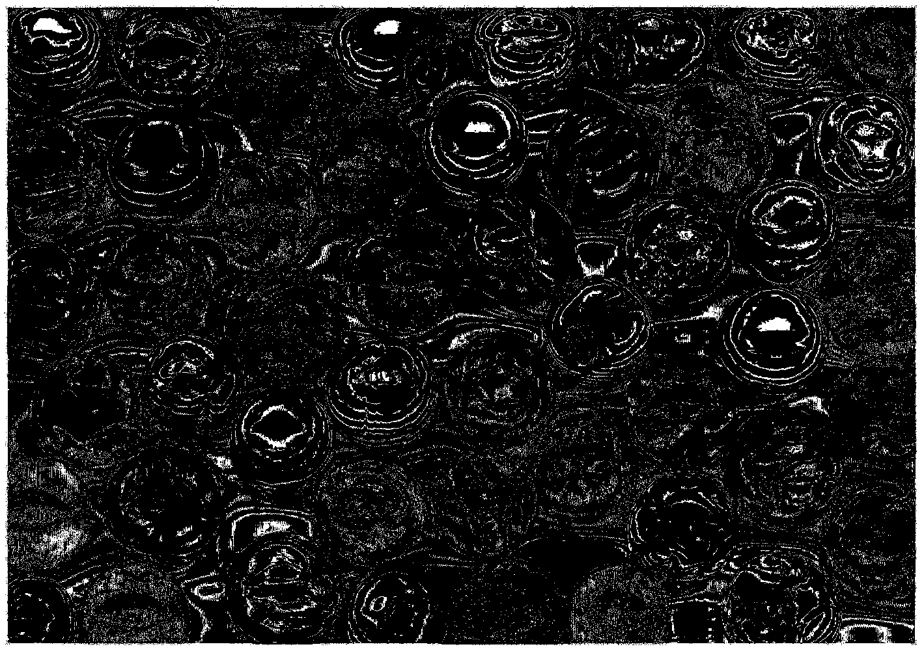
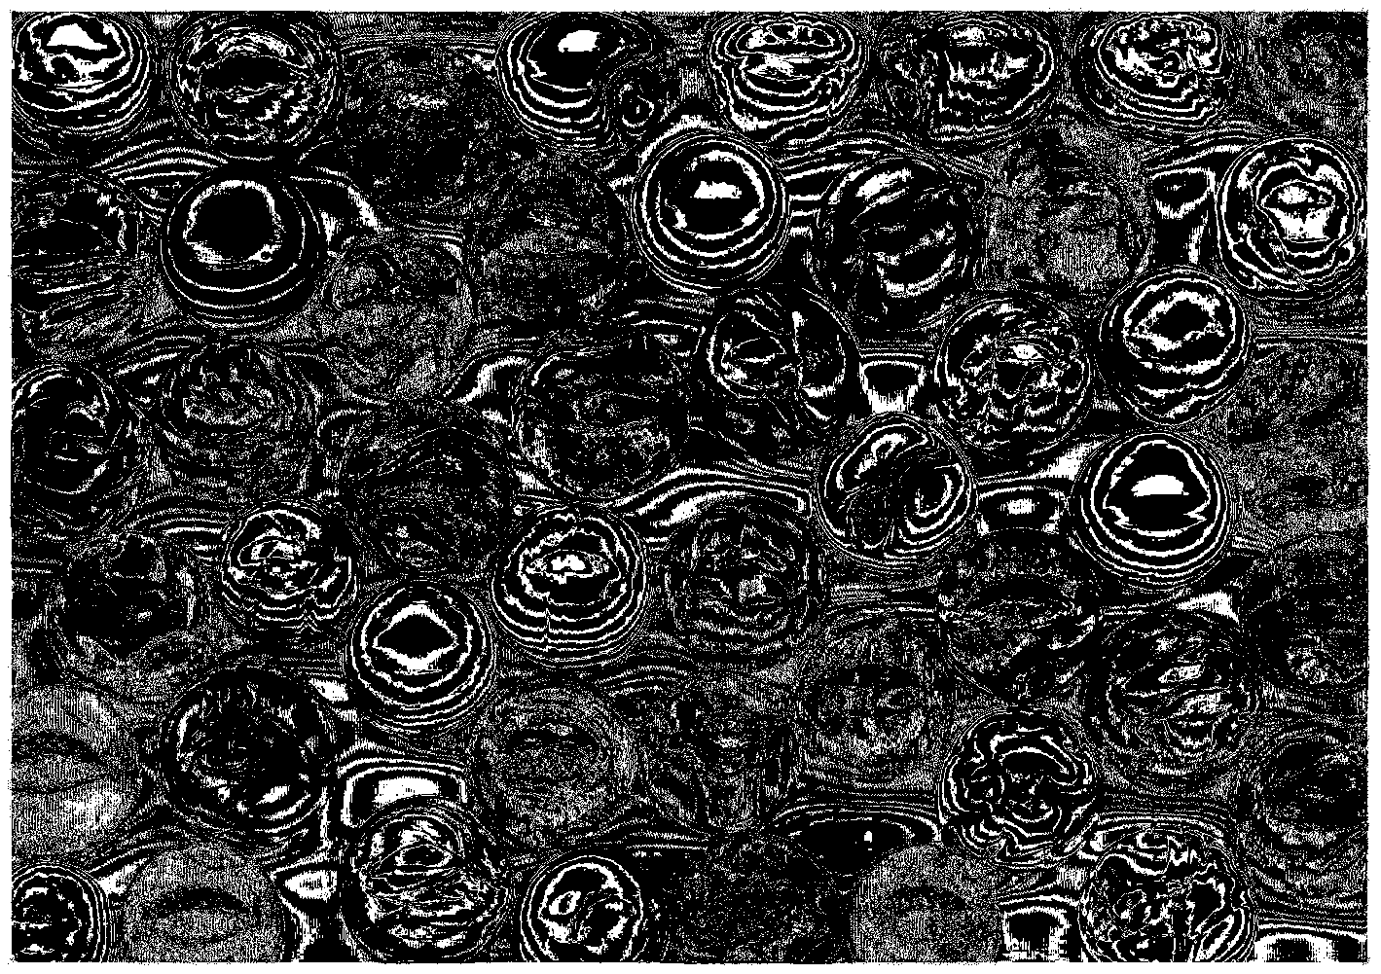
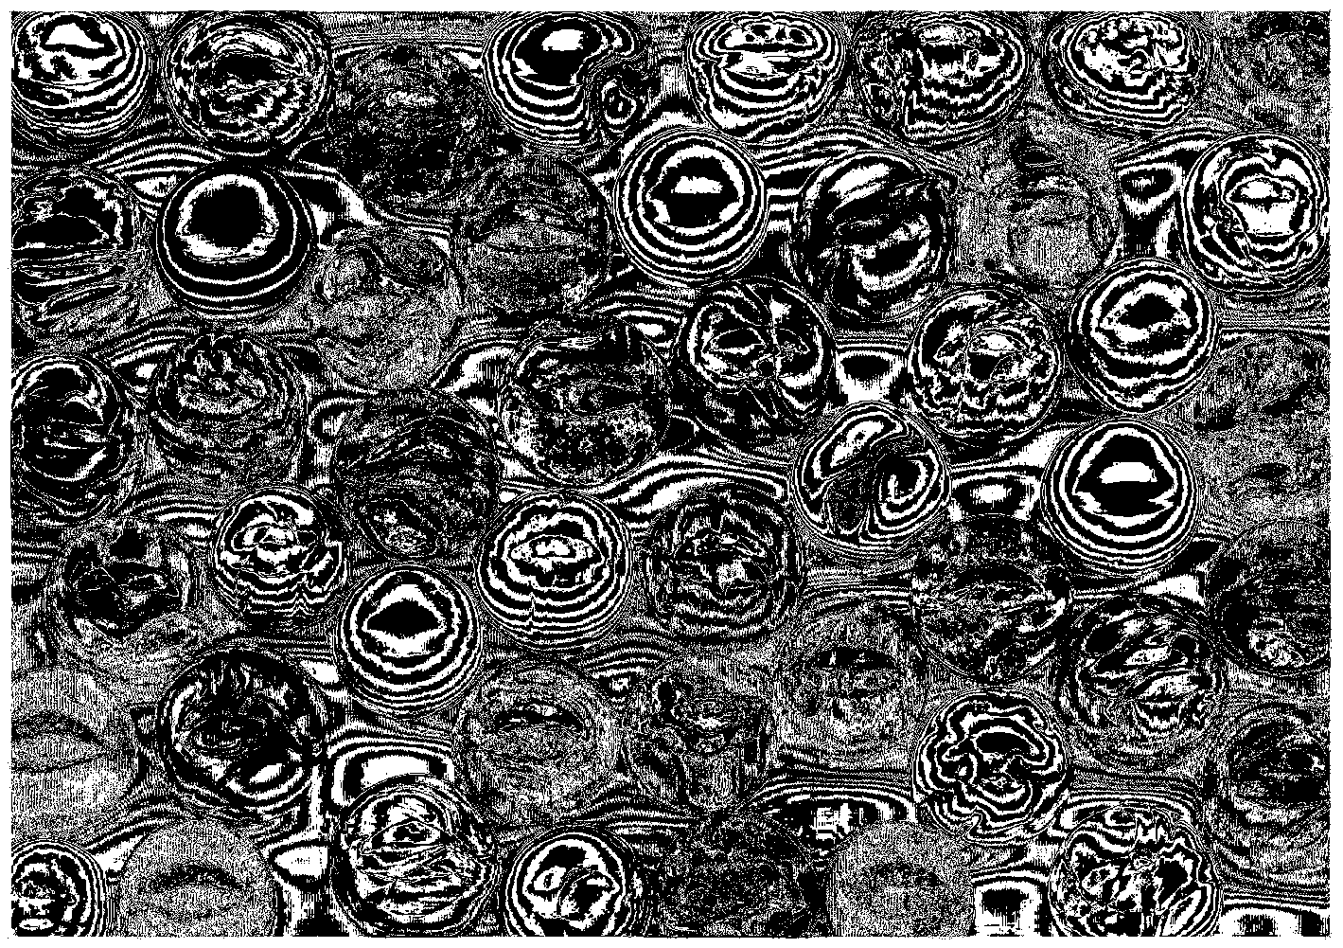
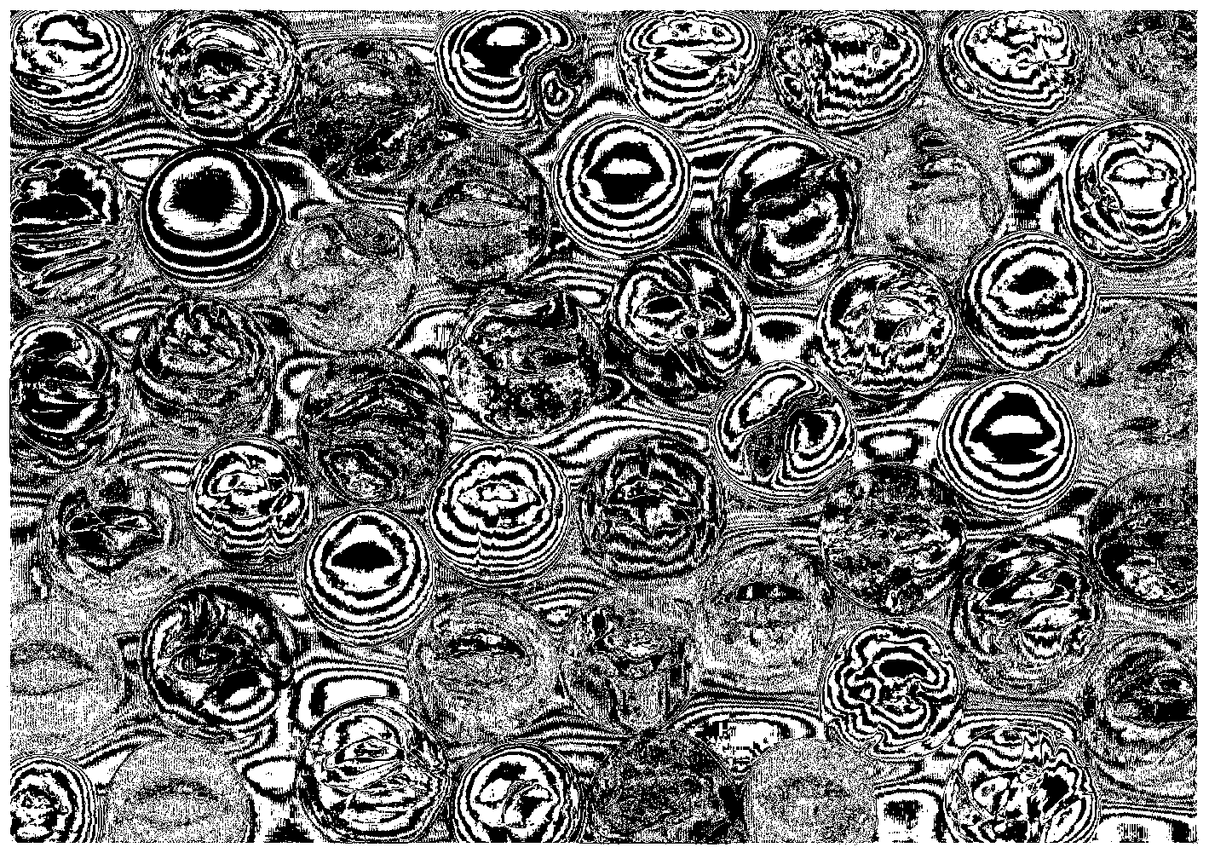
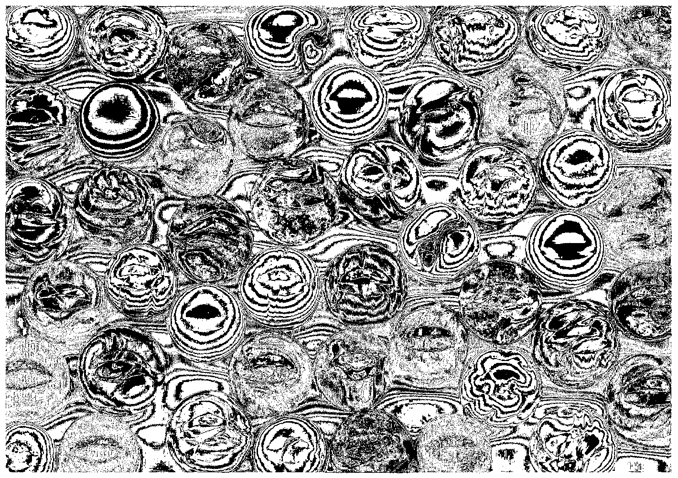
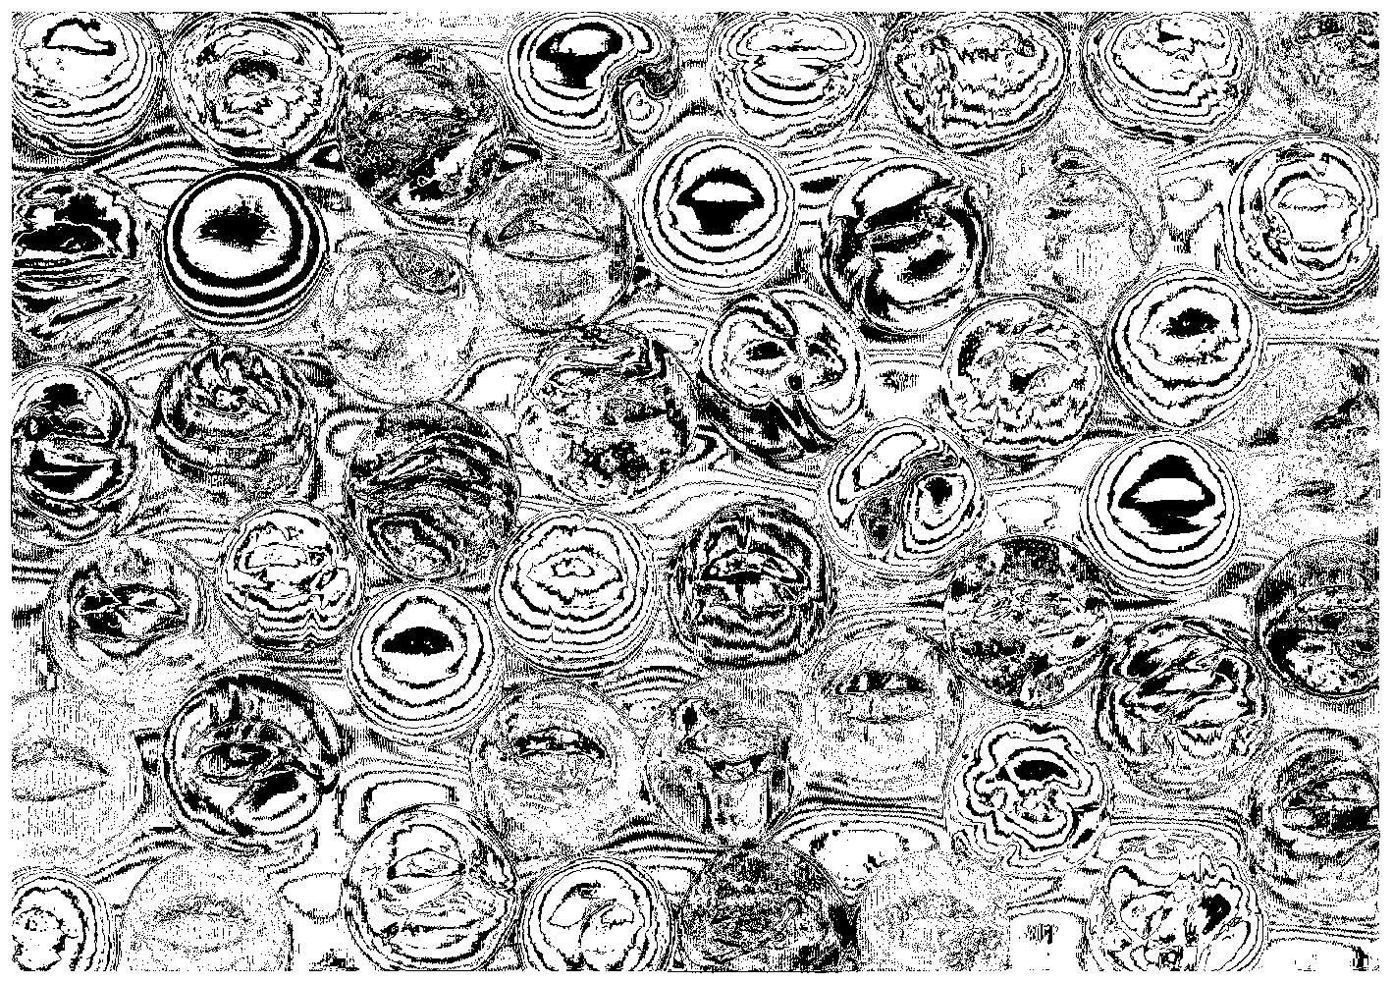
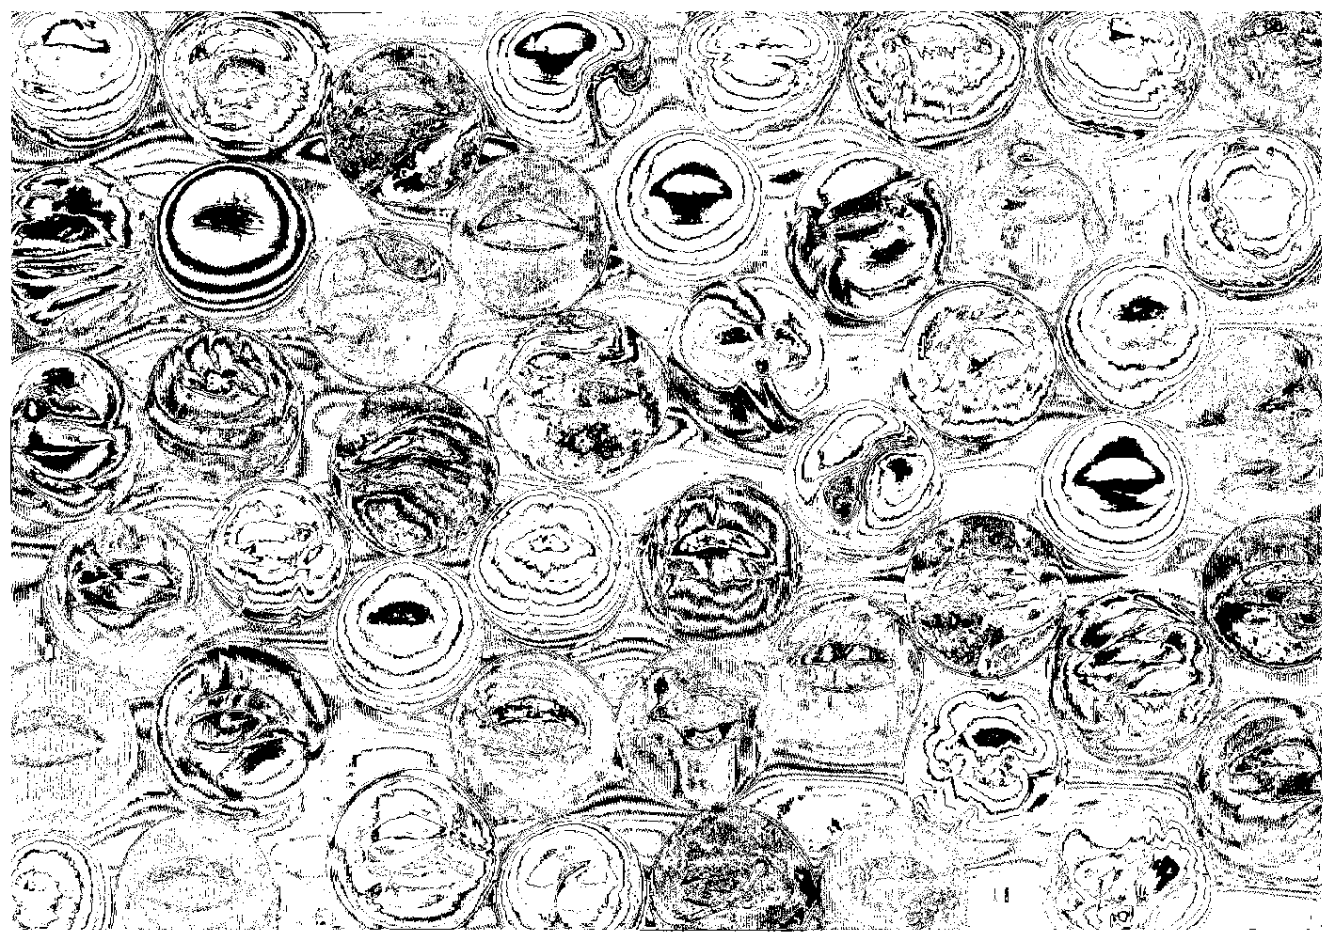
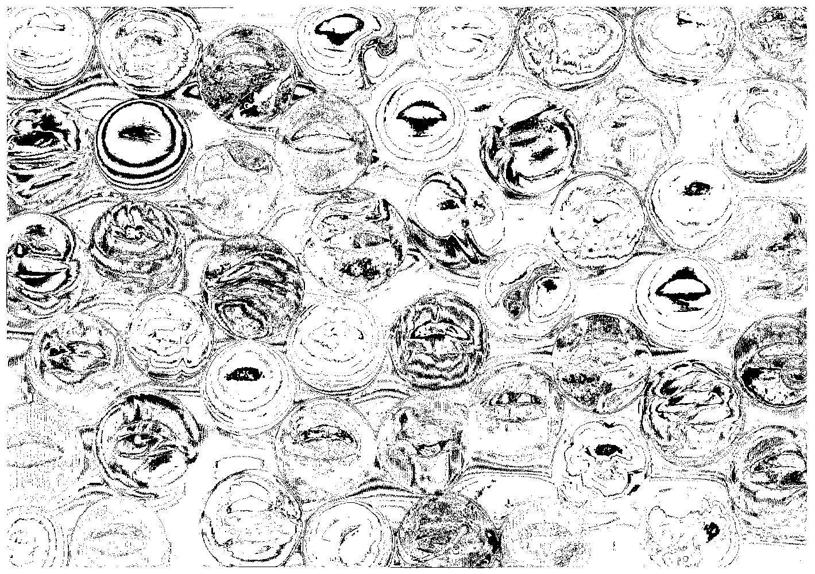
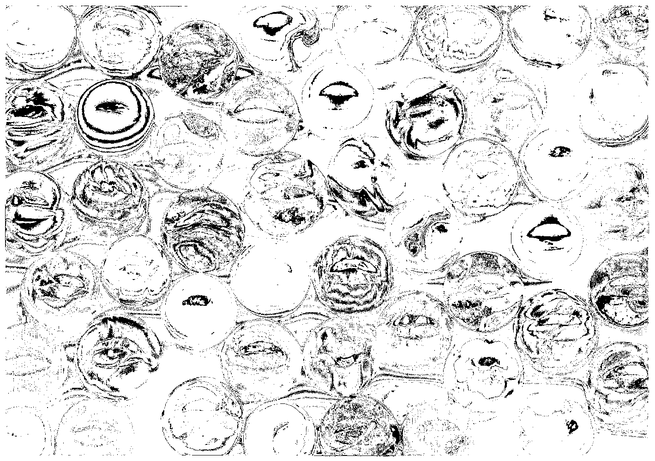
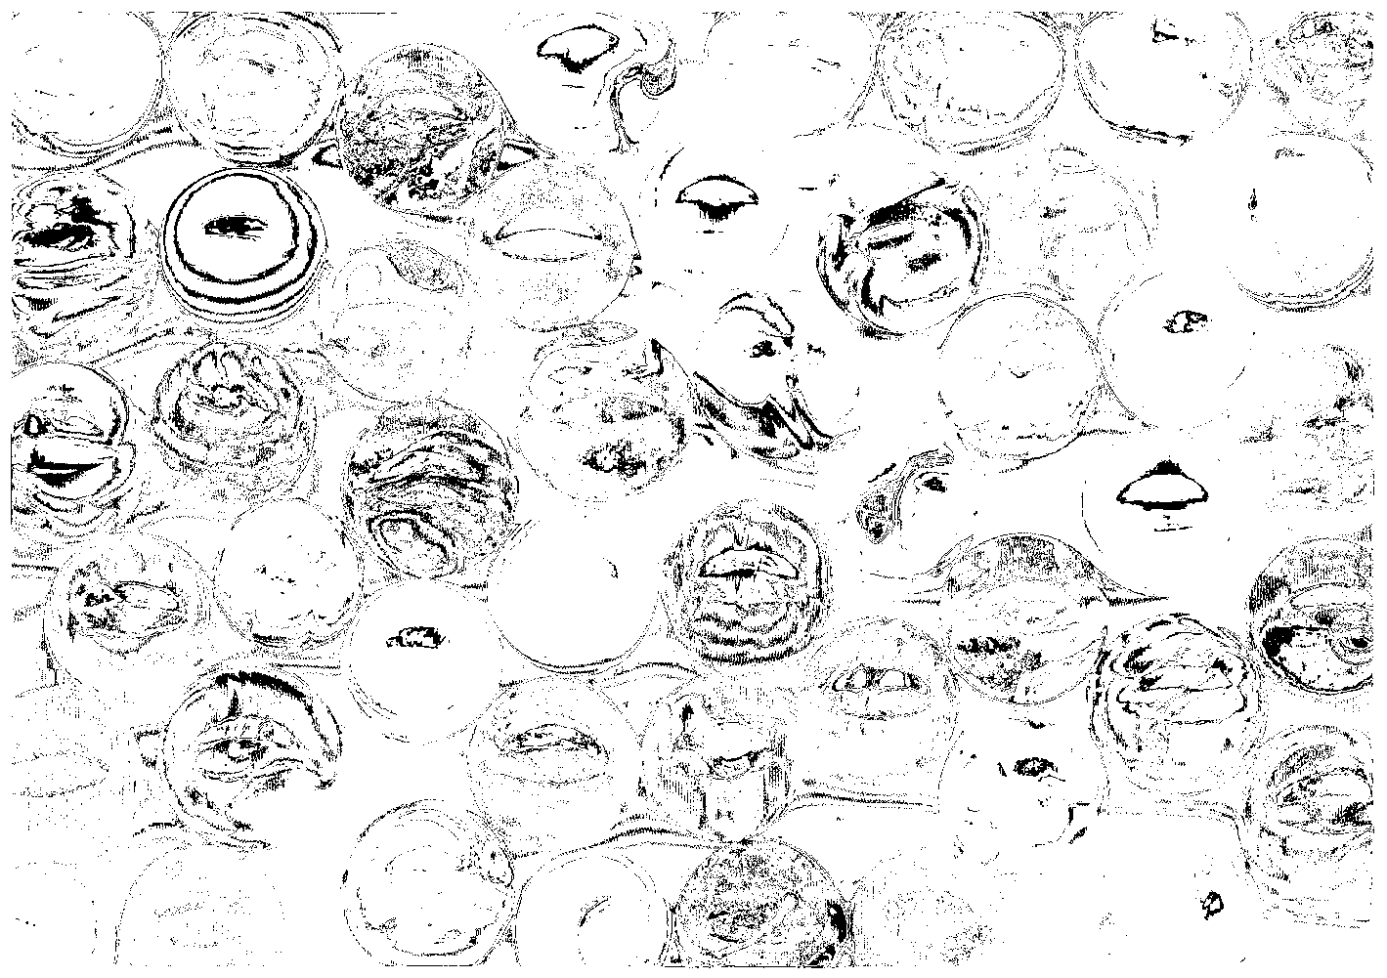
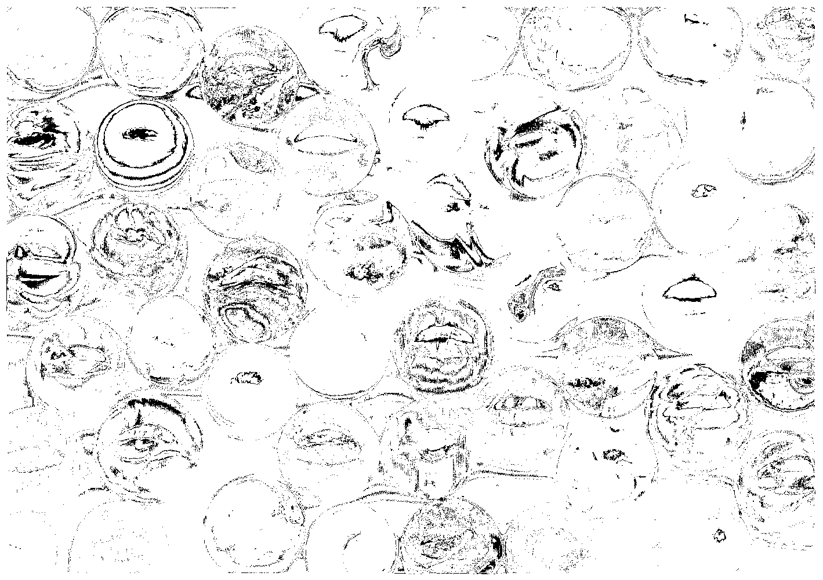
A
In this example we start with a high quality BMP file (A). Using an gif compression we make a second file (B)
As a visual guide, we can make a new gif image that “flips” between the two images – this helps us to localise differences between the images.
In some cases, inverting the difference image allows for better change localisation.
It hasn’t helped here especially, we can’t see where there is a difference clearly
This is the “difference” image. From this view its hard to see exactly where differences are found between the two images, and what the differences are.
B
The largest pixel difference depth is 43 steps. 2 pixel in the whole image show this level of difference.
As a reference, here are 3 squares of 43 steps difference between them.
There are 55,124 pixels with a difference depth of 1 step.
As a reference, here are 3 squares of 1 step difference between them
The difference image can be sliced into individual “difference depth” images and joined into a gif image for visual convenience. The first 12 of these images are shown along the bottom of this slide.
RMSE A|B = 12.29
Image A is not the same as image B.
Without more context about the two images, we can’t use this value further.

Slide 3
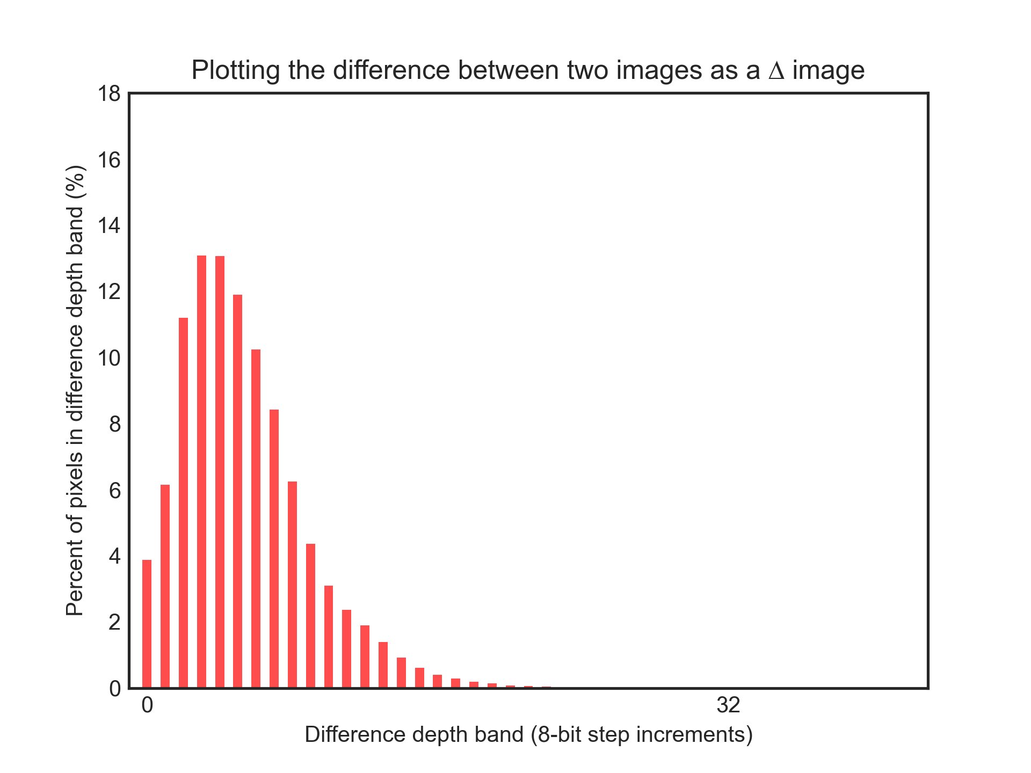
Change Level | # Pixels | % of Image
Unchanged | 55,124 | 3.8808%
1 | 87,376 | 6.1514%
2 | 158,907 | 11.1873%
3 | 185,712 | 13.0745%
4 | 185,452 | 13.0561%
5 | 168,850 | 11.8873%
6 | 145,465 | 10.2410%
7 | 119,479 | 8.4115%
8 | 88,581 | 6.2363%
9 | 61,886 | 4.3569%
10 | 43,890 | 3.0899%
11 | 33,652 | 2.3692%
12 | 26,945 | 1.8970%
13 | 19,693 | 1.3864%
14 | 12,964 | 0.9127%
15 | 8,608 | 0.6060%
16 | 5,676 | 0.3996%
17 | 3,994 | 0.2812%
18 | 2,684 | 0.1890%
19 | 1,874 | 0.1319%
20 | 1,135 | 0.0799%
21 | 760 | 0.0535%
22 | 540 | 0.0380%
23 | 377 | 0.0265%
24 | 238 | 0.0168%
25 | 167 | 0.0118%
26 | 112 | 0.0079%
27 | 89 | 0.0063%
28 | 68 | 0.0048%
29 | 40 | 0.0028%
30 | 22 | 0.0015%
31 | 16 | 0.0011%
32 | 15 | 0.0011%
33 | 9 | 0.0006%
34 | 6 | 0.0004%
35 | 3 | 0.0002%
36 | 2 | 0.0001%
37 | 2 | 0.0001%
38 | 3 | 0.0002%
40 | 1 | 0.0001%
41 | 0 | 0.0001%
42 | 0 | 0.0000%
43 | 2 | 0.0001%
For that same marbles image, we can analyse the data in the difference images and find out how much of the image as a percentage of total pixels has changed.
There are lots of things we can do now that we have quantified the amount of difference between these two images.
By assessing the number of difference bands that are found, and especially noting the largest band value, we can get a sense of the depth of change between the image. We might set an organisational policy that allows difference depths up to a given band when making access copies. We can do the same the number of pixels at each band level – e.g. max 5% of image at difference band 1, 3% at band 2 etc.
We might expect a minimum of n pixels unchanged (e.g. 50% of image at band 0).
We can use the visualisations to locate change, and with the charts, have data driven conversations about impact of processing on images
We can use this technique to identify and articulate processing impacts on non image formats, by making those formats into images, and running this technique over the resulting images.
We can add that data to a chart that allows us to “see” the bands of depth of change, and the number of pixels affected at each band.

Slide 4
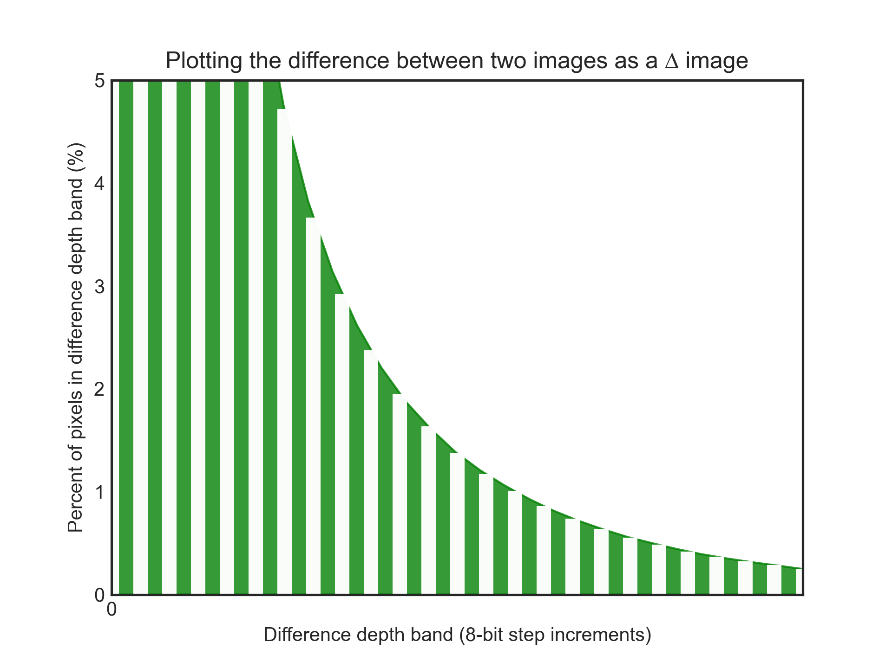
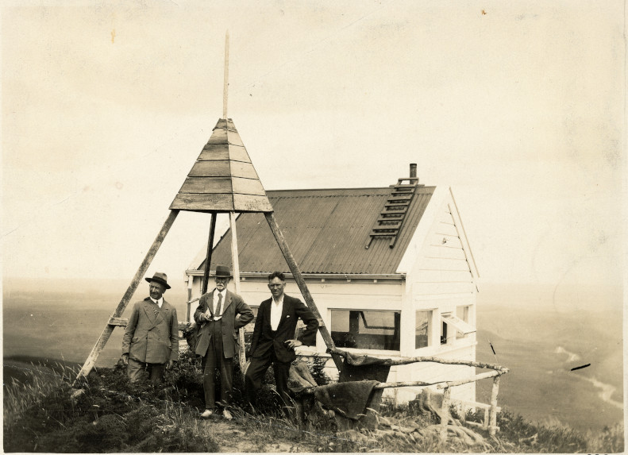
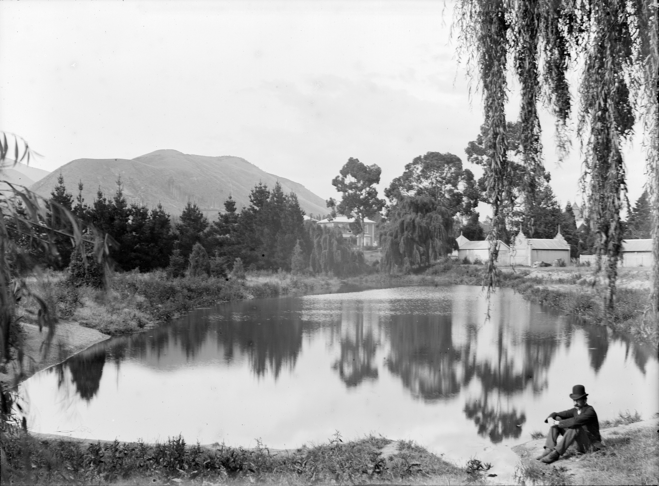
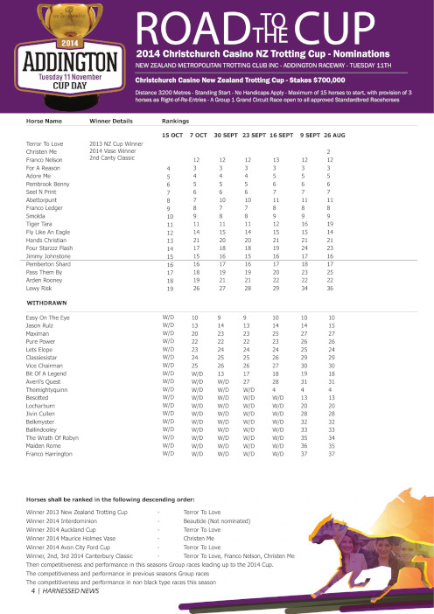
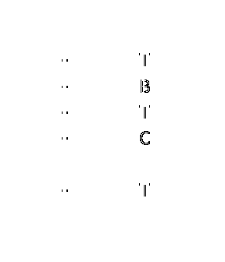
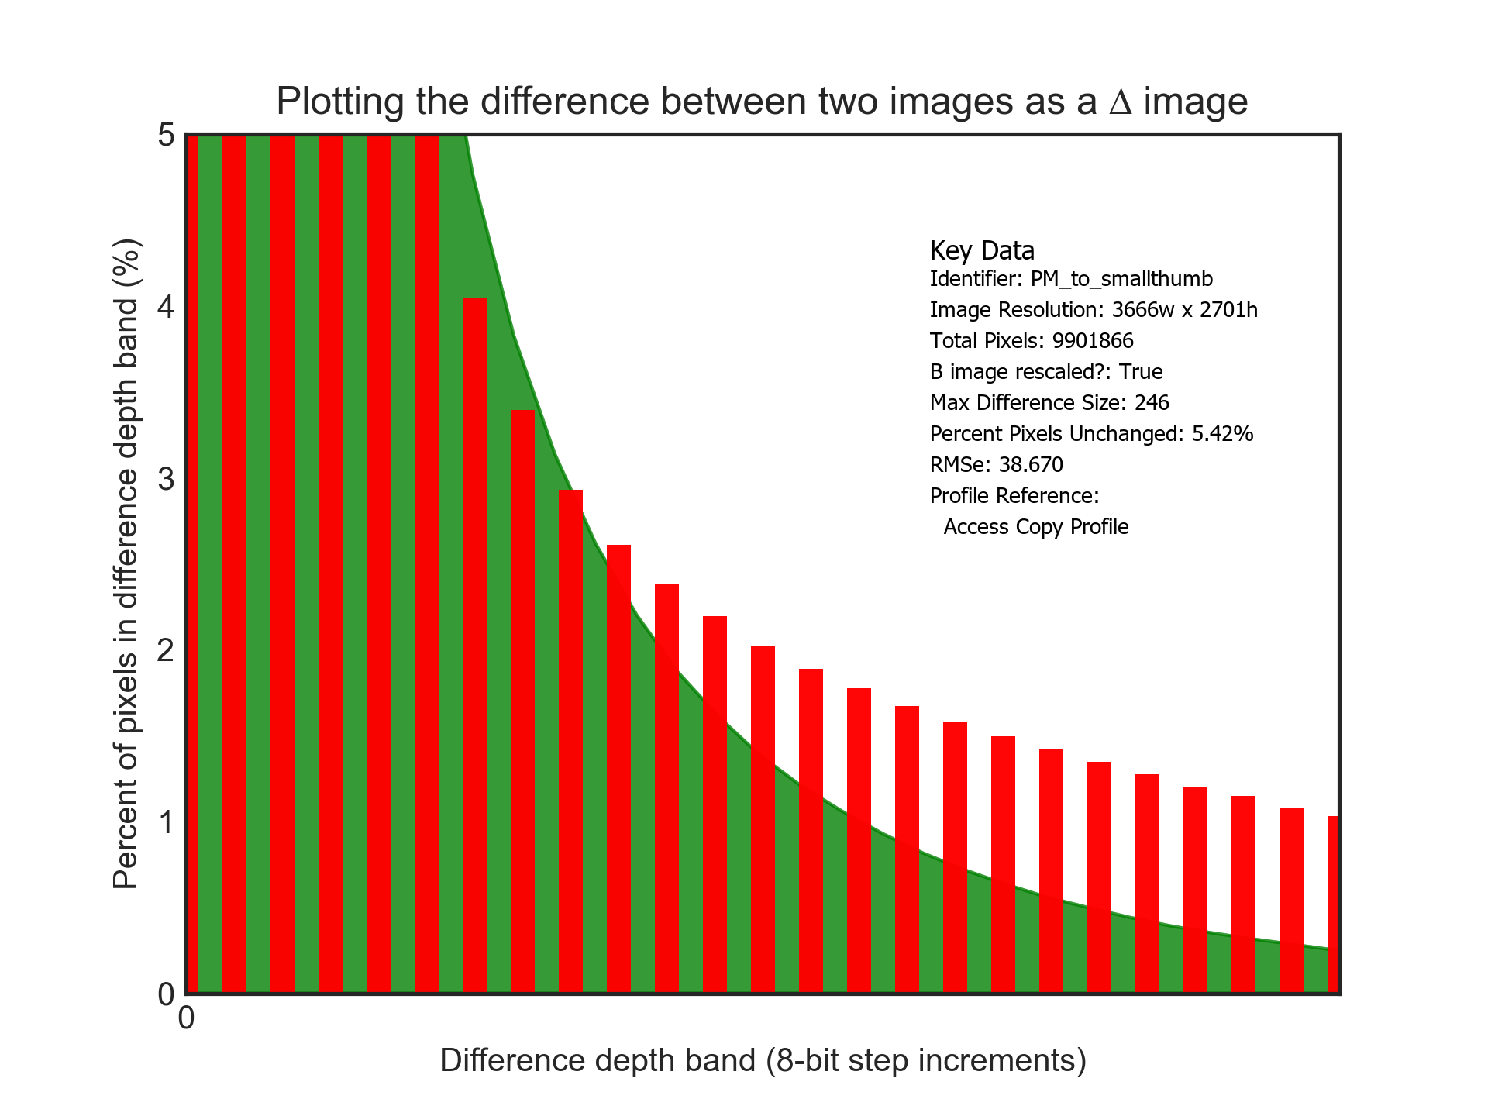
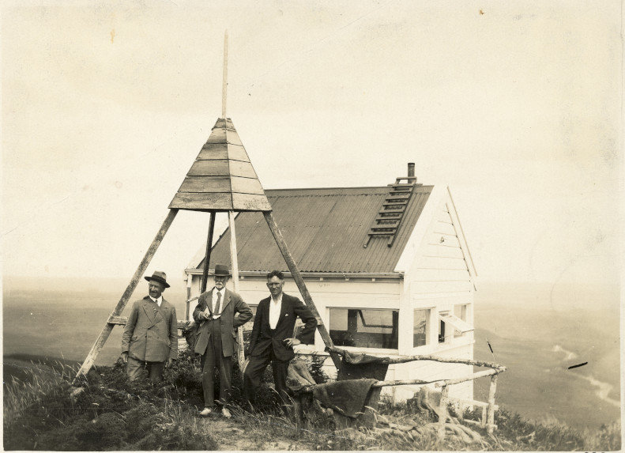
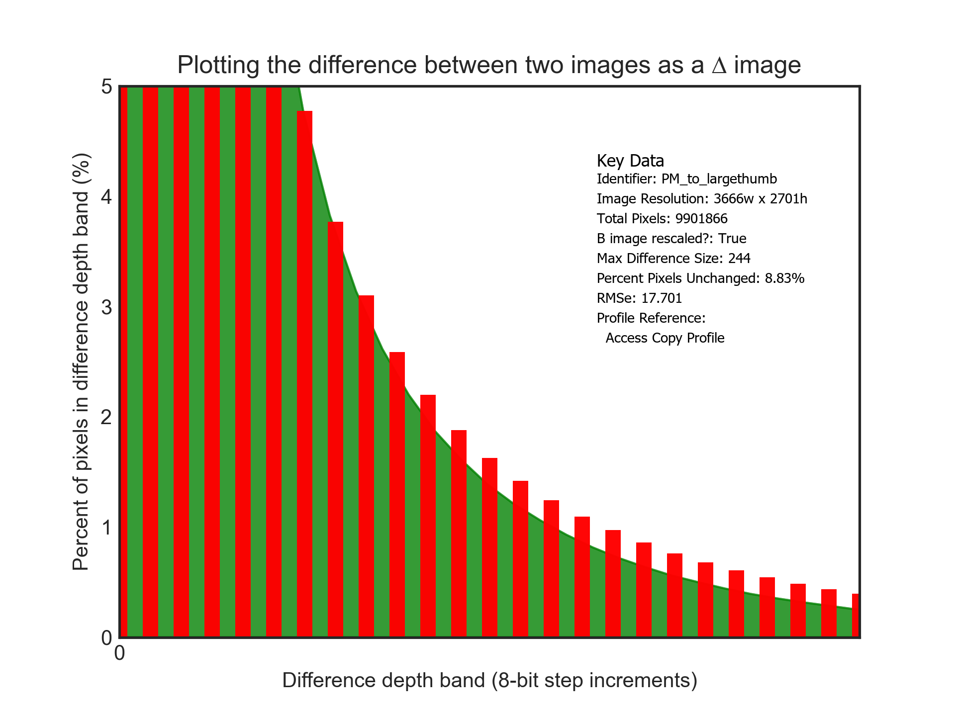
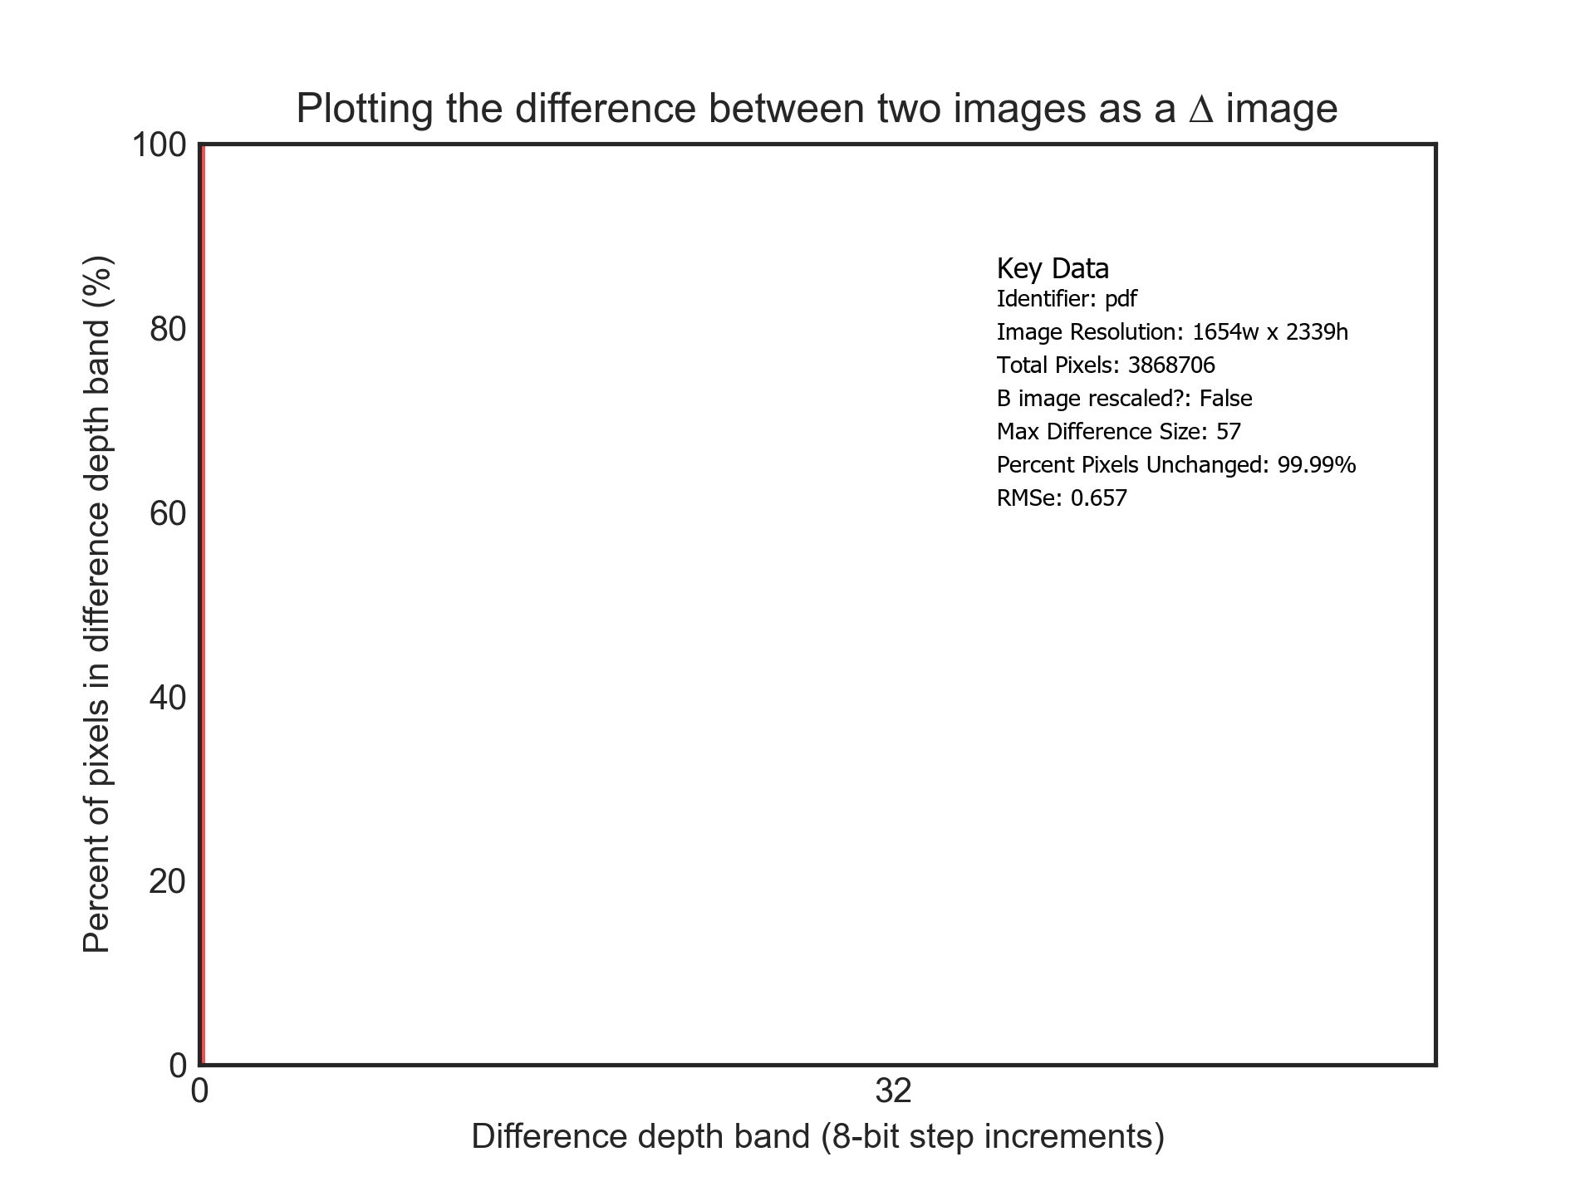
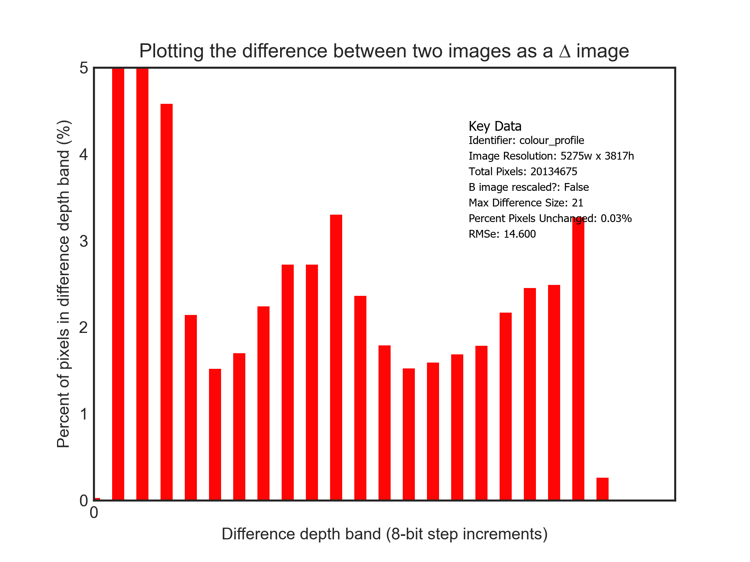
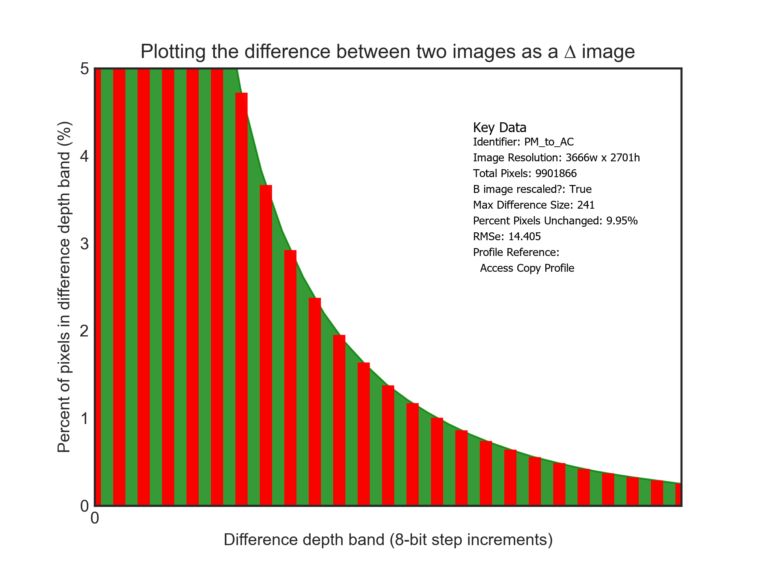
UC1: A new process is being tested to address a validation risk found in some image files.
Test of potential treatments revealed in issue with how colour profiles are being managed
UC2: Creating access copies of master files must meet a fidelity criteria.
UC3: Processing to fix a validation issue with a PDF file results in files with different fixity values. Human inspection can not locate any changes. Image diff analysis shows where those differences are so stakeholders can assess the impact. In the example below it was ~200 pixels in one location that experienced some text/font rendering difference.
Example acceptable change profile for access copy versions of high fidelity digitised photographs
A digitised photograph is ingested into repository. Part of ingest process is to create a series of access copies for a mixture of usages.
This copy fails the change profile test as it has changes outside the bounds. Access copy image was too small.
This copy fails the change profile test as it has changes outside the bounds. Access copy image was too aggressively compressed
This copy passes the change profile test as all changes are within the agreed profile.

